Slide 1
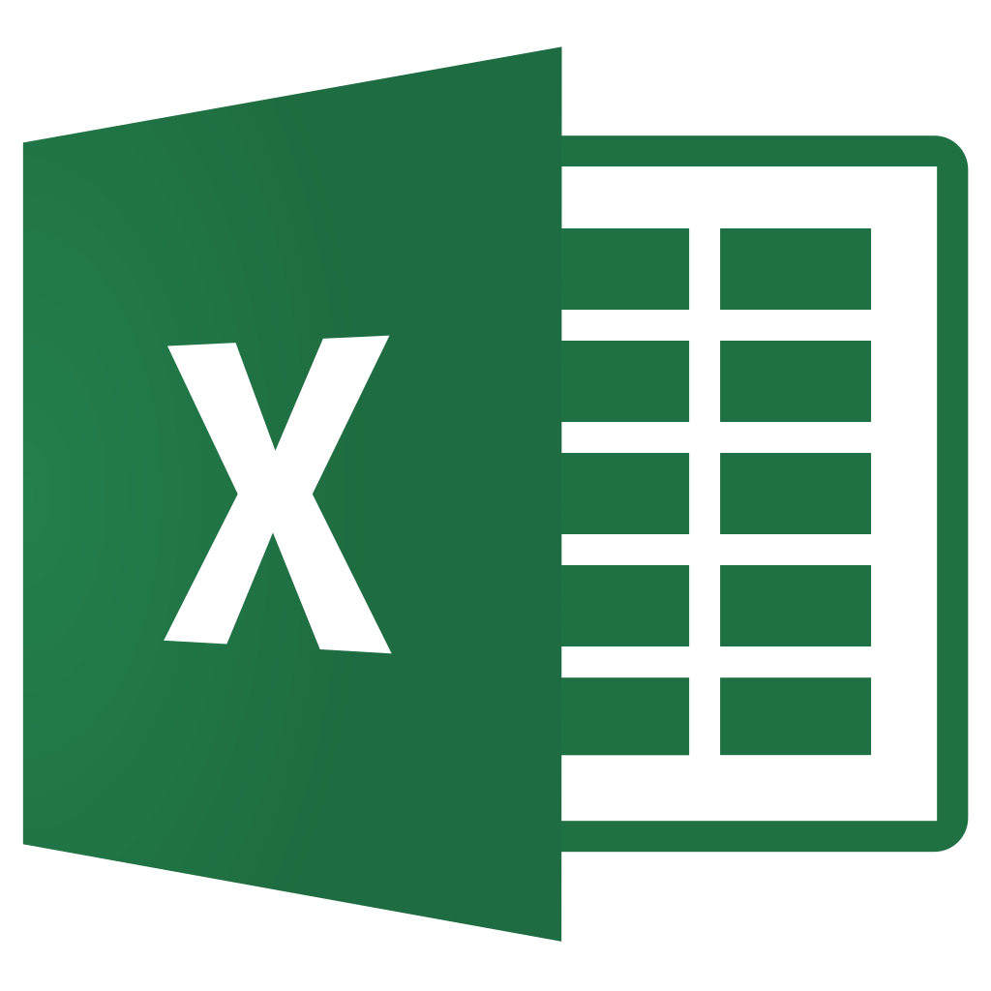

What Libraries Will We Use?

Slide 2

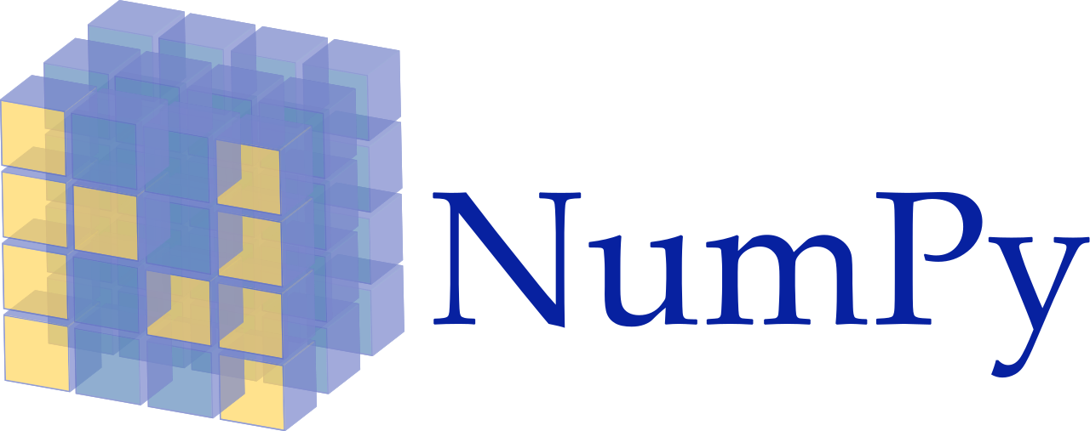


Pandas
NumPy
Matplotlib
SkiKit-Learn

Slide 3
Extract, Transform, and Load
Data Exploration
Data Evaluation
Data Modeling

Slide 4
Open source data analysis and manipulation tool
Build on top of Python

Slide 5
Provides fast, flexible, and expressive data structures
Designed to make working with data easy and intuitive

Slide 6
Good to use with:
SQL table or Excel spreadsheet
Time series data
Matrix data
Observational / statistical datasets

Slide 7
Handle missing data
Mutate size
Align data
Convert data into DataFrame objects
Join datasets
Pivot data sets
Time series functionality

Slide 8
Python 2D plotting library

Slide 9
Generate plots, histograms, bar charts, scatterplots and more with a few lines of code

Slide 10
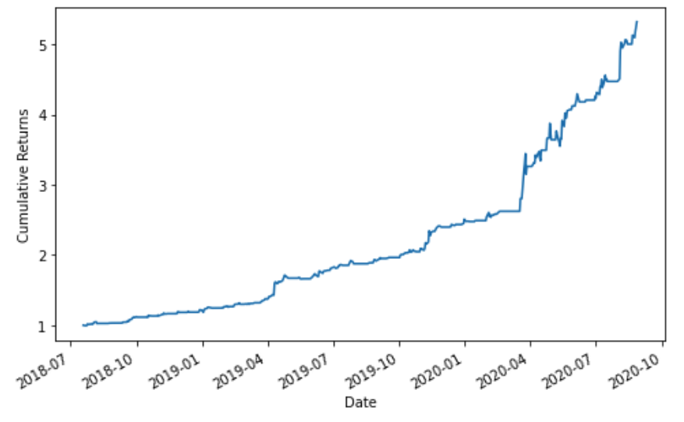
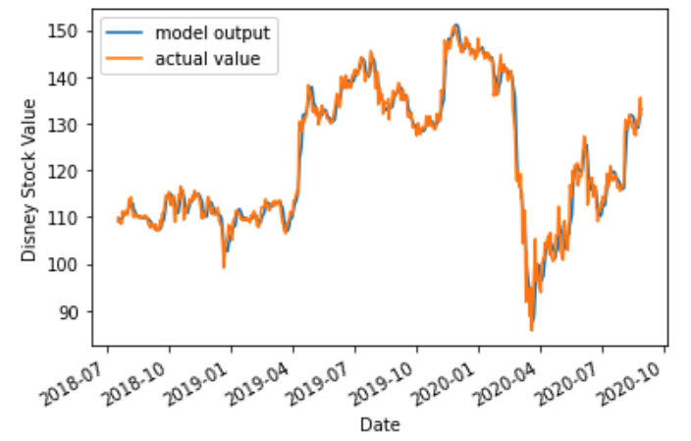
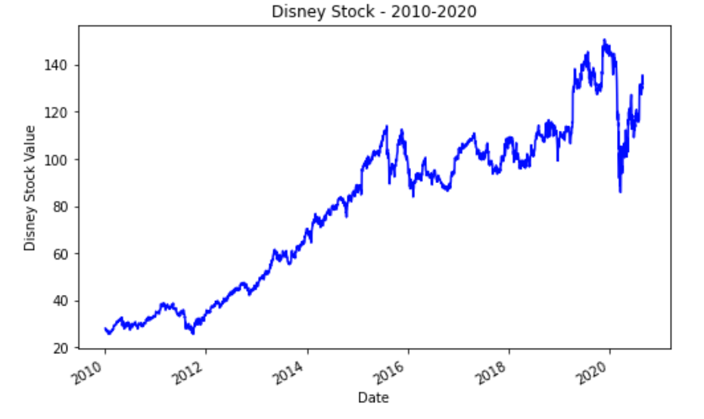

Slide 11
Scientific computing with Python

Slide 12
Powerful n-dimension arrays
Mathematical functions and more numerical computing tools

Slide 13
Simple and efficient tools for predictive data analysis

Slide 14
Classification
Regression
Clustering
Dimensionality reduction
Model selection
Preprocessing

Slide 15
What Libraries Will We Use? ✓
Let’s begin...

